Slide 1
Reports
Grade 11 and 12 CAT

Slide 2
Reports
Used to present data from a table or a query in printable format
The easiest way to initialise a report is to use a report wizard
Once a basic report is structured you can make changes to suit your application

Slide 3
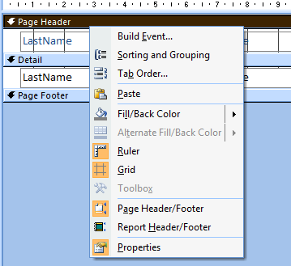
Headers and Footers
Page header and footers occur on every page of the printed report.
Report headers and footers occur at the beginning and end of the entire report.
Right click to activate each if they are not available.
Resize by dragging the bottom boundary up or down

Slide 4
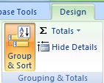
Grouping
It is possible to group data entries according to a specific field
On the design ribbon choose Group and Sort
It will display the following at the bottom of the design. Choose Add a group.

Slide 5
Grouping (2)
Once you have chosen to add a group this will display at the bottom of the design. You can then build up your groups

Slide 6
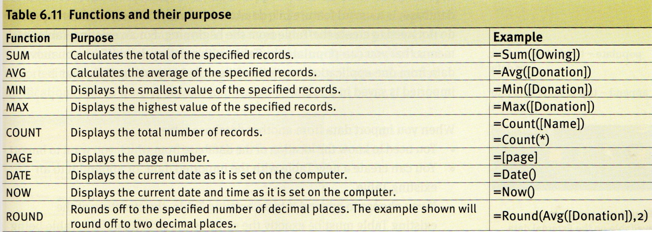
Calculations in Reports
Grade 12 ONLY
Calculations in reports start with an equal sign followed by the calculation type. The actual calculation is enclosed in round brackets. If you require a field it is enclosed in square brackets. Build them up in an inserted text box.

Slide 7
Calculations (2)
Round Brackets
= Sum([price])
Square Brackets
equals
function
field

