Slide 1
Hardware
Grade 12 CAT

Slide 2
Model of a computer system
storage
Input
processing
output
communication

Slide 3
Hardware
Input Device Integration
QR codes
Buying decisions
Input Units
Output Units
Primary Storage
Secondary Storage
Bibliography

Slide 4
Input Device Integration
Touch screen
Bar code reader
Keyboard
Mouse
These can all be used on one system to increase productivity.

Slide 5
Further integration
Biometric
Facial recognition
Fingerprint scanner
Iris scanner
Voice recognition
While all of these are pretty secure using two or more of them increases security. One or more could also be used with a keypad password.

Slide 6
QR codes
Many products are using QR codes. These “pictures” can be used to go to a web page, take advantage of offers etc.
You can take a picture of the code with your phone
Software translates the code.
The code can be words, numbers or web addresses etc.

Slide 7
Buying Decisions
Before buying a computer system or an i/o or storage device you need to have some knowledge.
You need to keep up to date with what is available.
You need to understand the computer terminology involved.
Be aware of what is more suitable for your needs.
Refer to pages 12 to 20

Slide 8
Input - keyboards
Desktops normally have a numerical keypad and some specialised keys like Home and Page up etc.
Laptops and netbooks usually incorporate the numbers and special keys on the main keyboard.
There are various styles – some claiming to be ergonomic
Can be wireless

Slide 9
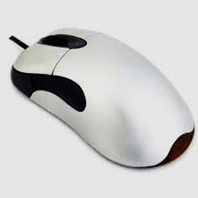
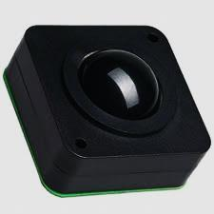
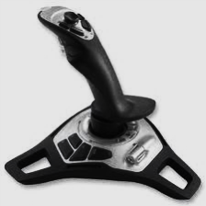
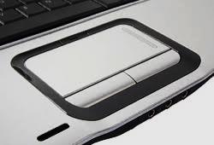
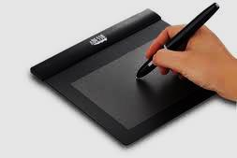
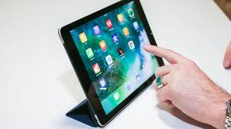
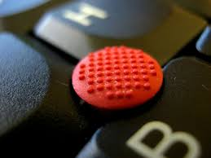
Input – pointing device
Mouse (mechanical, optical, wireless)
Trackball
Joystick
Touchpad
Stylus pen
Touchscreen
Pointing stick

Slide 10
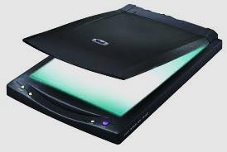
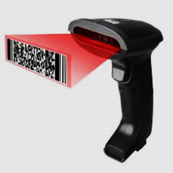
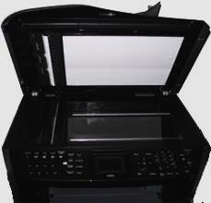
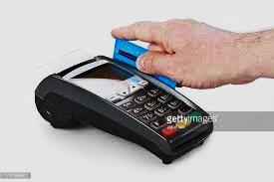
Input – Scanners - Types
Flatbed scanners – outmoded now
Handheld scanners (usually used to read bar codes)
Multifunction printers have an inbuilt scanner/copier (MFP)
A card reader scans a magnetic strip on a credit card, buying card etc.

Slide 11
Input – Scanners - Operation
Most scanners can scan in two modes – either as a
pdf file – this is for typed documents. These can usually not be edited but the text can usually be copied and pasted into a Word Document. It is usually possible to add pages so that a document’s pages can be saved as one file.
Jpg or gif or png or other picture format.
Optical Character Recognition (OCR) is a 3rd mode. This often produces editable text.

Slide 12
Input - Voice Recognition
Often called “speech to text”
Enables hands free computer usage
A huge advantage for some disabilities
Many vocational areas are using software to faciltate speech recognition:
Military
Education
Medical
…to name a few

Slide 13
Input – Smart Speakers/Phones
Can be connected to many things (Internet of things) like your garage door, aircon unit.
Examples are Google Home and Amazon Echo.
Apple are working on a Siri based speaker which may incorporate facial recognition.
Cell phones use Siri (Apple), Cortana (Microsoft) and Vlingo (android) to name a few

Slide 14
Output – Printers - types
Ink Jet – sprays ink onto the page
Laser – works like a copier – uses toner
LED – similar to laser – uses diodes rather than toner
Thermal – works on heat
Dye Sublimation – uses dye to transfer the image

Slide 15
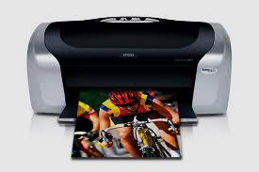
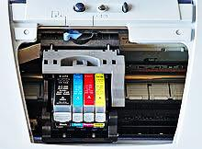
Output – Ink Jet Printer
High quality print and graphics (300 dpi or more)
Cheaper than laser
Slower than laser
Cost per page is generally higher than laser so used in situations where output is small
Mostly used at home or in SOHO situations

Slide 16
Output – Laser printers
Fast and fairly economical for big runs so is popular for businesses
Laser makes an imprint on the drum which passes over the toner. The paper passes over the drum and a page is printed.
Printing quality is at least 300dpi but generally more.

Slide 17
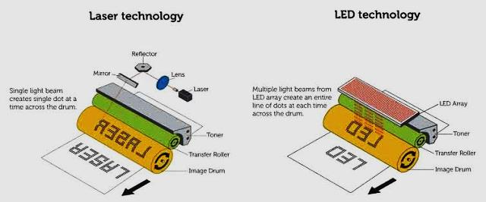
Output – LED printers
Similar to a laser printer but it is light instead of laser but…
It has less moving parts
It is lighter
Usually has a faster print rate
LED → Light Emitting Diode

Slide 18
Output – LCD printers
These are also similar to the laser and LED printers but …
Use light which is shone through an LCD panel to create the image on the drum
It produces a print that is similar in quality to the other two
LCD → Liquid Crystal Display

Slide 19
Output – Thermal Printers
This printer uses thermal (heat sensitive) paper.
It uses heated pins which will imprint on the heat sensitive paper.
The print quality is not very good and can fade over time.
Cash registers and ATMs generally use these printers

Slide 20
Output – Dye-sublimation printers
These are sometimes called Dye-diffusion printers
They are used to print on fabric, plastic and paper.
They are used in the processing of ID cards

Slide 21
Output – 3D Printers
Used to create models of almost anything.
They put layers of plastic (or other material) to match a predefined shape.
They are becoming more commonplace.
People are exploring the fun side of modelling.
They are experimentally being used in many areas of the medical field with great success.

Slide 22
Primary Storage
It is essential memory that is housed inside the computer.
ROM is memory stored on chips that teaches the computer how to do things. Memory is retained when the computer is switched off.
RAM is volatile. It is short term storage. Active programs and our data are stored on RAM. The speed of a computer is affected by the size of RAM

Slide 23
Secondary Storage
This is external, removable storage.
Examples are USB, CD, DVD and external hard drive.
CD’s and DVD’s are becoming obsolete.
Cloud storage is becoming very popular with many firms specialising in it. The most well known one is Dropbox

Slide 24
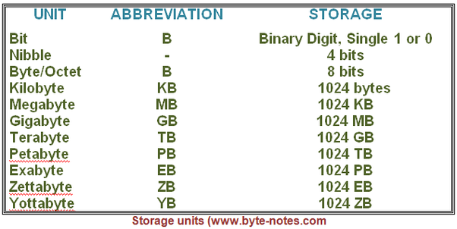
For more detail see:
www.computerhope.com/issues/chspace.htm

Slide 25
Communication
Communication → the sending and receiving of information from one computer to another.
Done via cards, cables and/or specialised hardware.
Software enables the device to work with all the other equipment.
Software sets up a system of protocols called handshaking

Slide 26
Other shows
Theory
Communication
Internet
Networks
Threats
Social Implications
Software
Booting Up
Computer Systems
Hardware
Practical
Word Processing
Spreadsheet
Data Base
HTML

Slide 27
Bibliography
www.wikipedia.com
www.nextadvisor.com
www.webopedia.com

